Slide 1
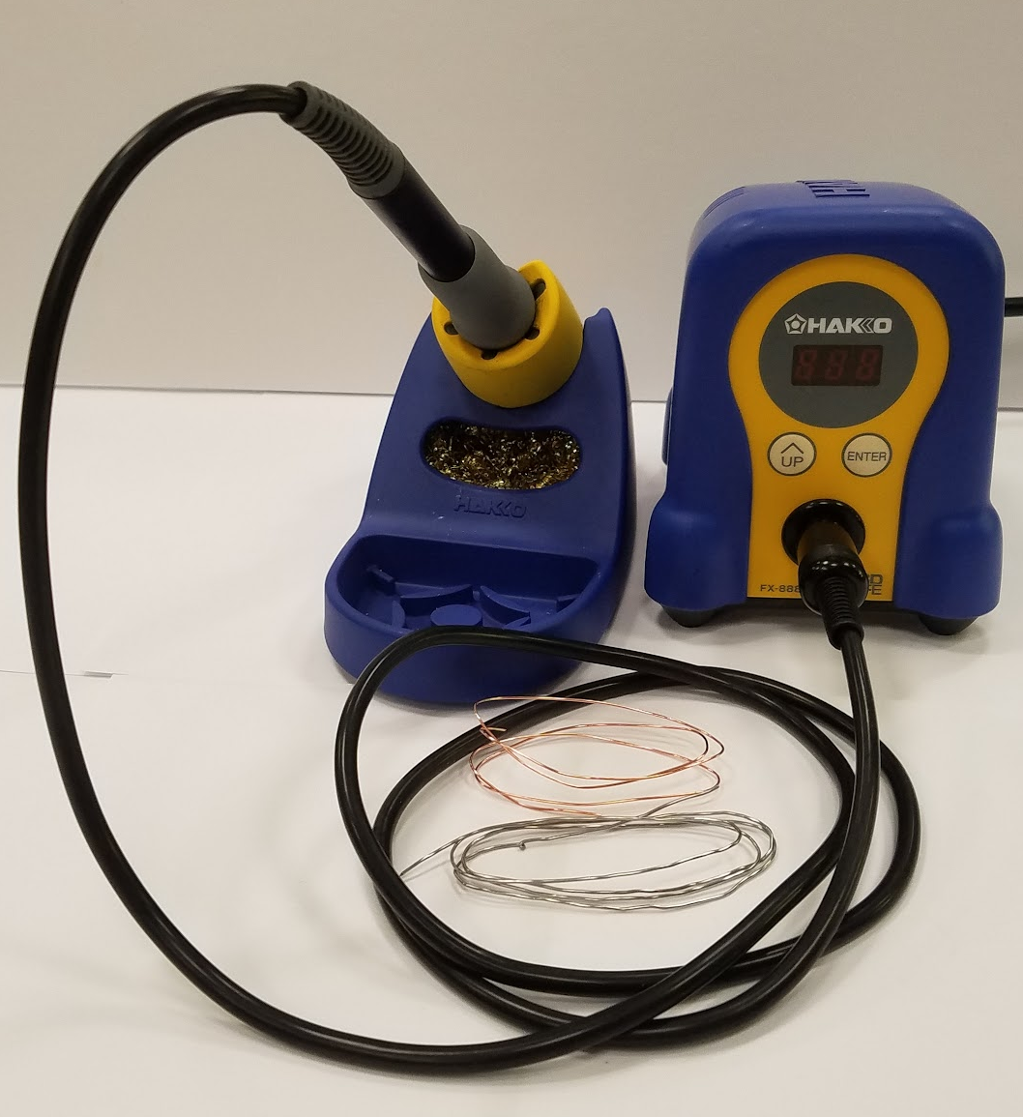
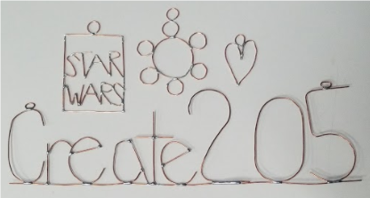
Soldering
Teens Engineer Birmingham
Instructors : Allaire Doussan & Mohsine Taarji

Slide 2
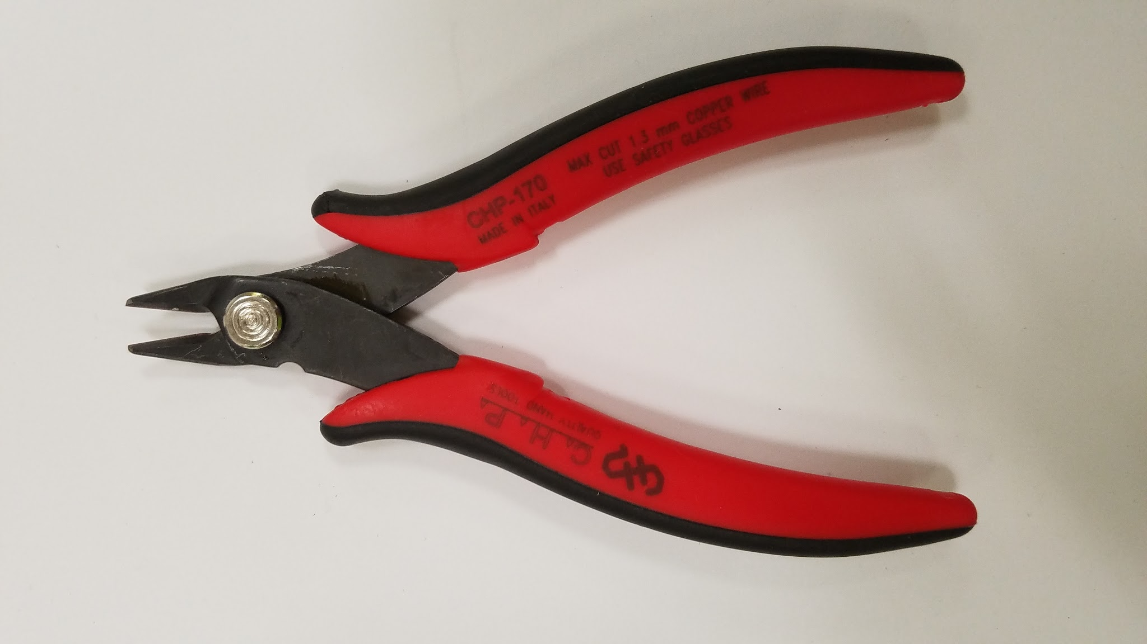
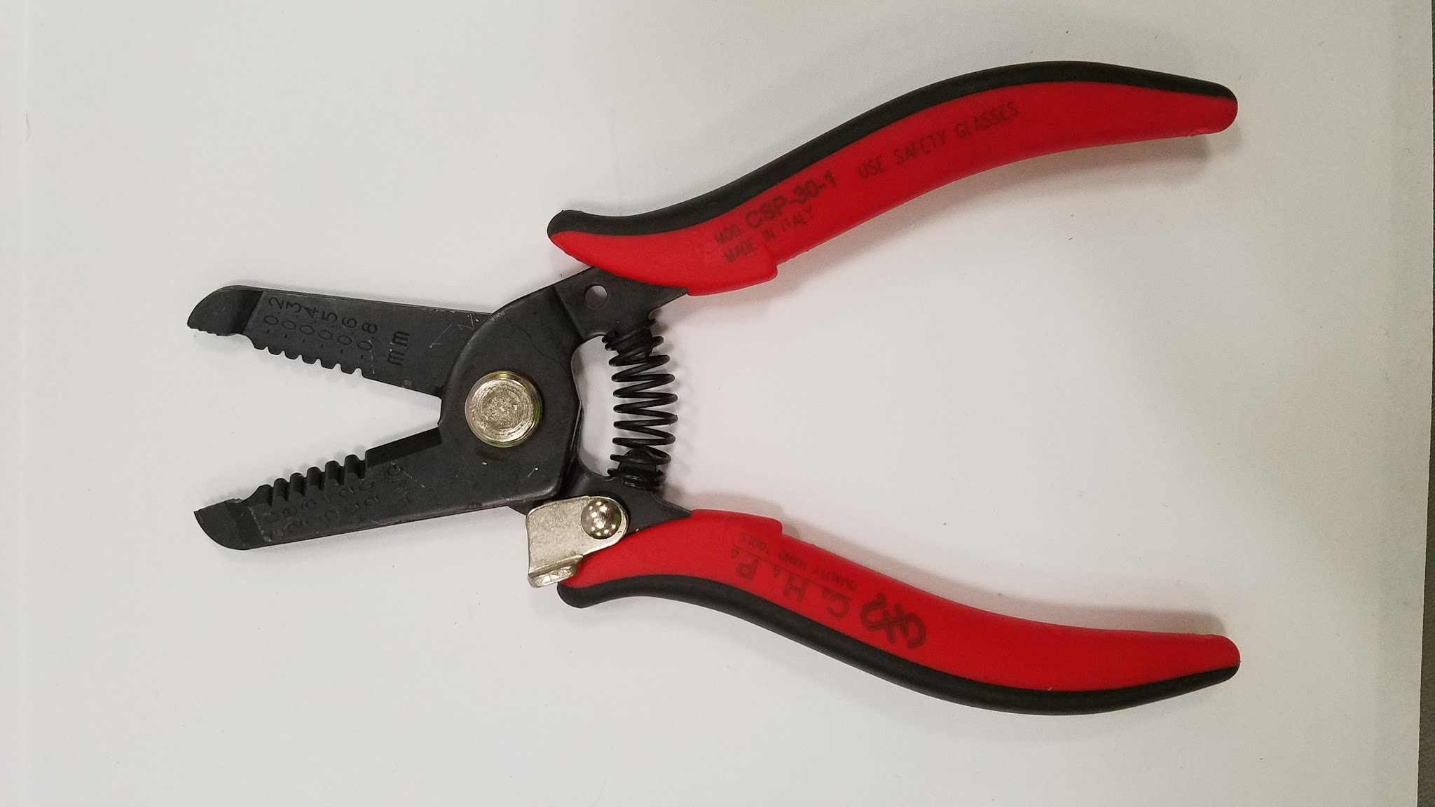
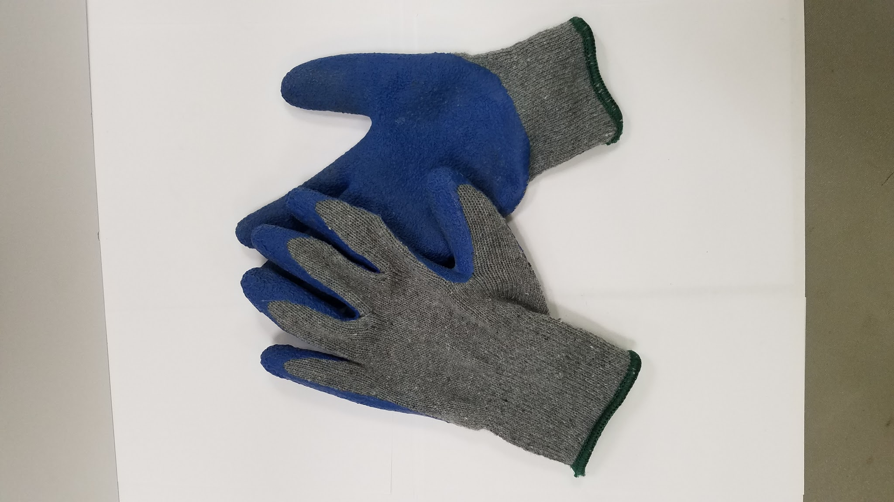
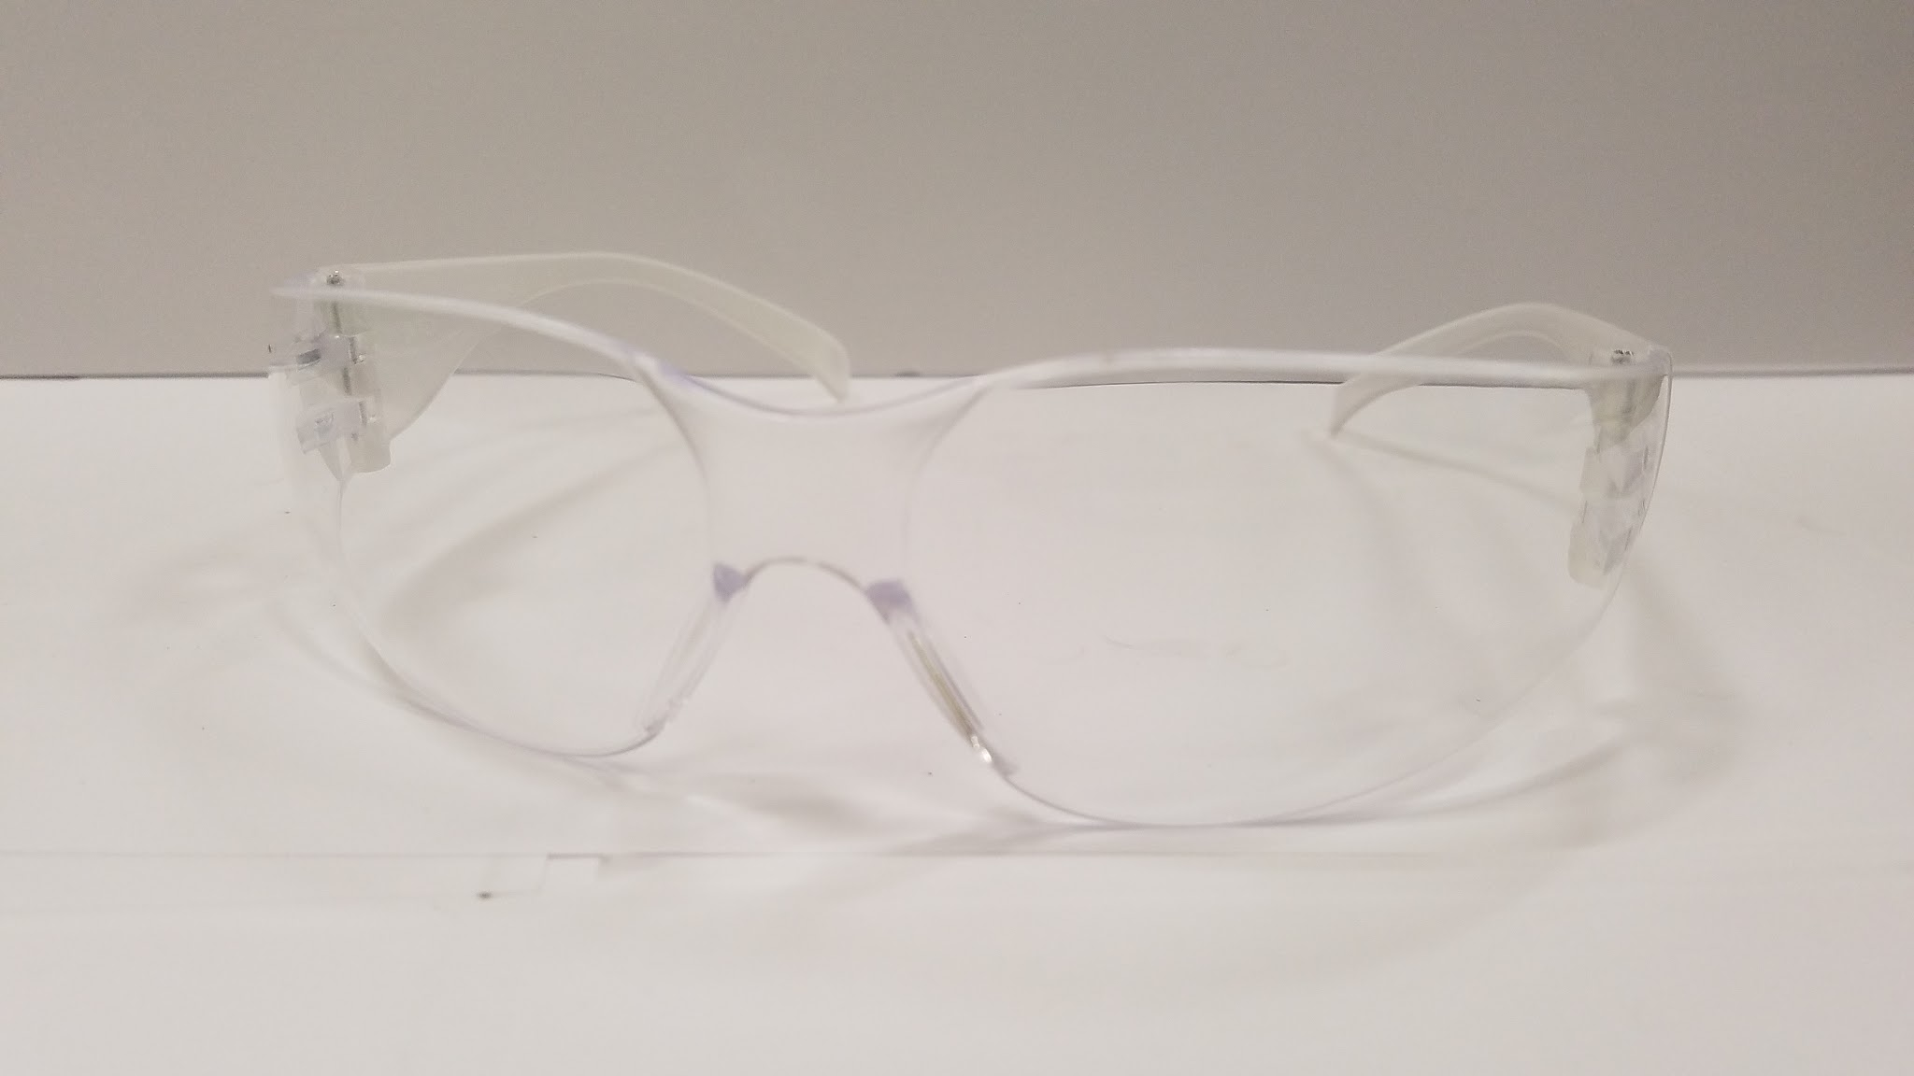
Tools
Wire Cutters
Wire Strippers
Safety Glasses
Soldering Iron
Gloves

Slide 3
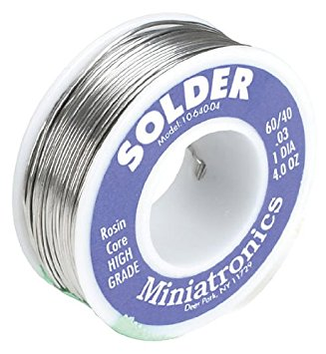
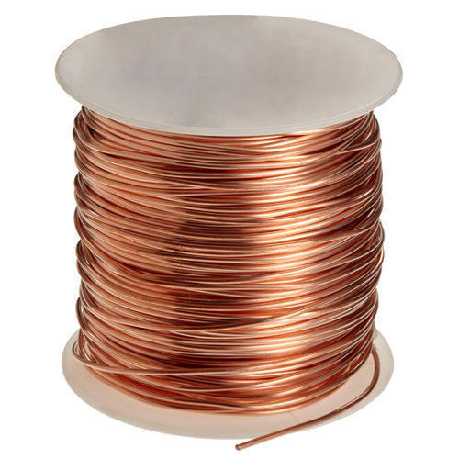
Components
Solder
Copper Wire

Slide 4
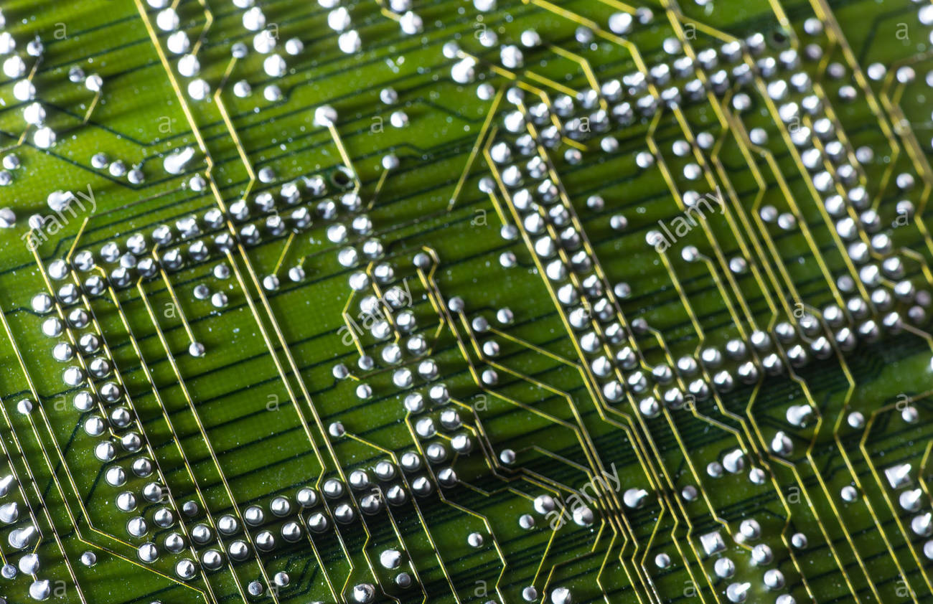
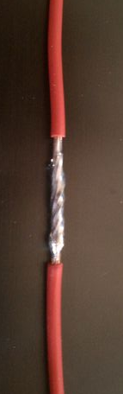
What is Solder Used For?

Slide 5


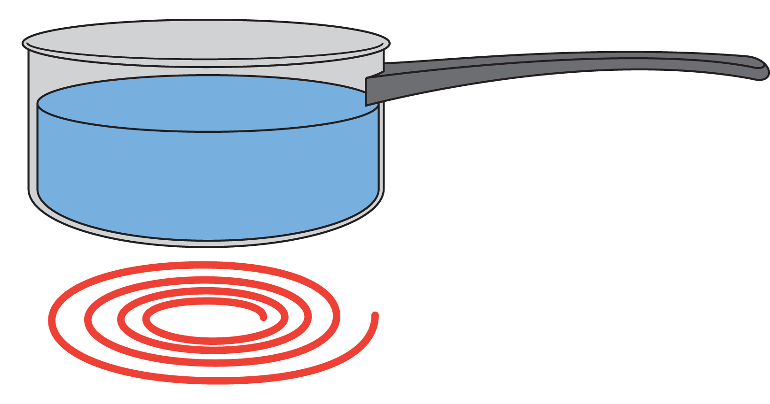
Conductive Materials
Conducts heat or electricity
Copper
Aluminum
Silver
Gold
Water
Metals

Slide 6

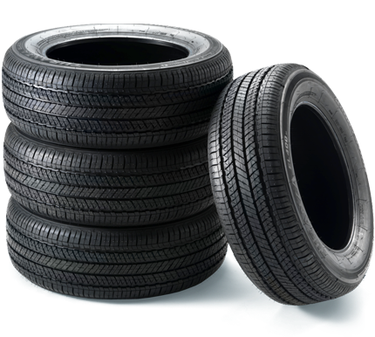
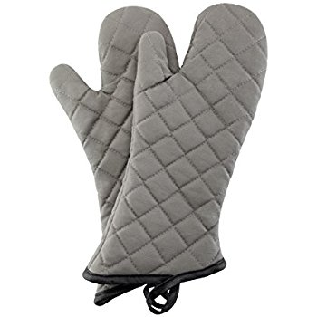
Nonconductive Materials: Insulators
Does not conduct heat or electricity
Plastic
Rubber
Glass
Wood
Fabric

Slide 7
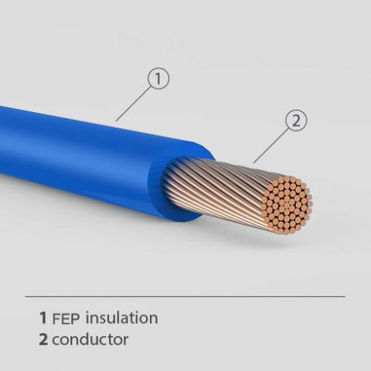
Electrical Wires
Inside: Conductive
Conducts electricity
Outside: Nonconductive
Surrounds the conductor and prevents...
Electrocution
Short circuits
Electrical fires

Slide 8
Safety
Wear glasses at all times!
Wear gloves while soldering!
Do NOT touch the metal part of the soldering iron, it is 750 ℉!

Slide 9
Practice Soldering: Connect 2 wires!

Slide 10
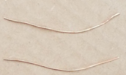
Step 1: Cut 2 pieces of copper
Cut two pieces of copper, about 2 inches long

Slide 11
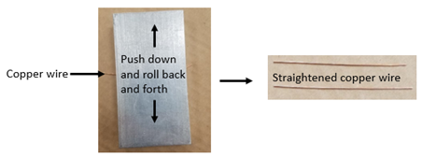
Step 2: Straighten the pieces of copper using a flat piece of metal

Slide 12
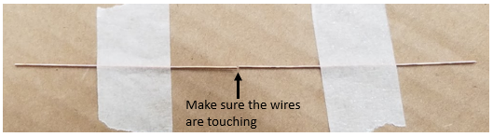
Step 3: Tape the wires down

Slide 13
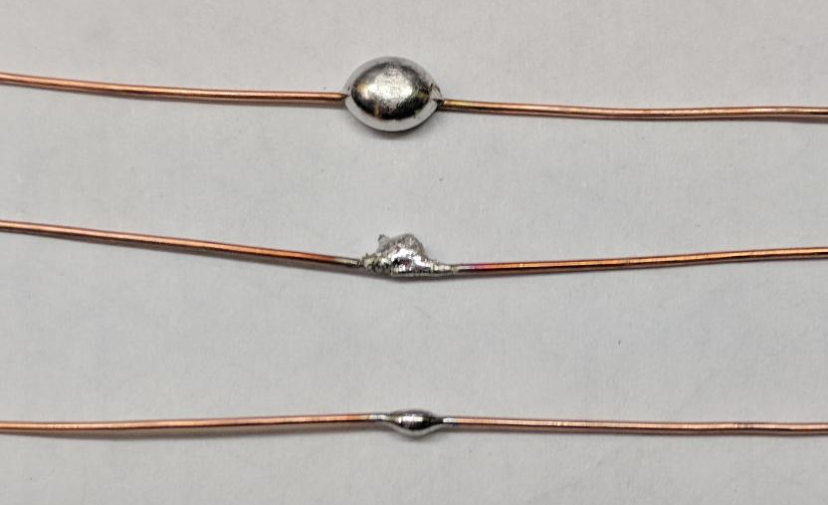
Soldering Joints
Too much
Heated for too long
Just right!

Slide 14
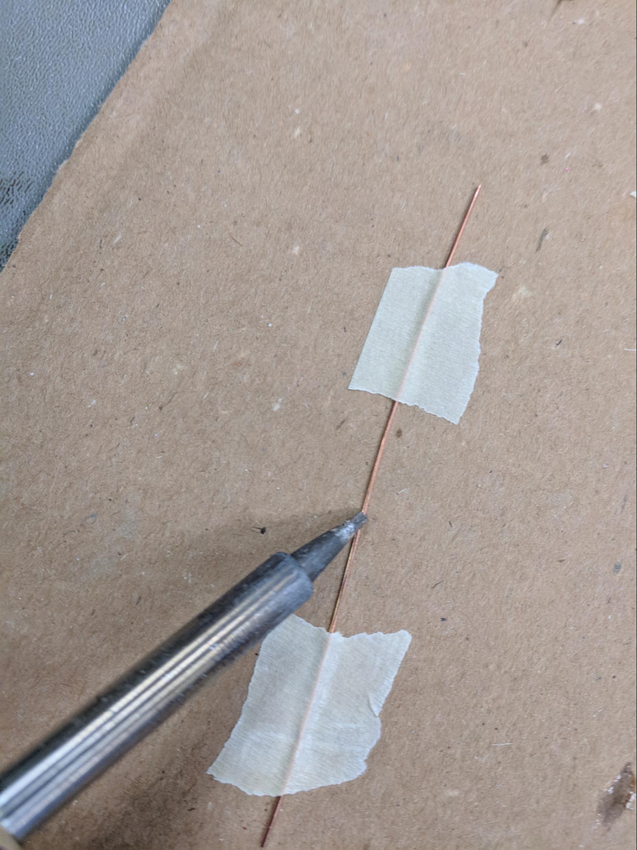
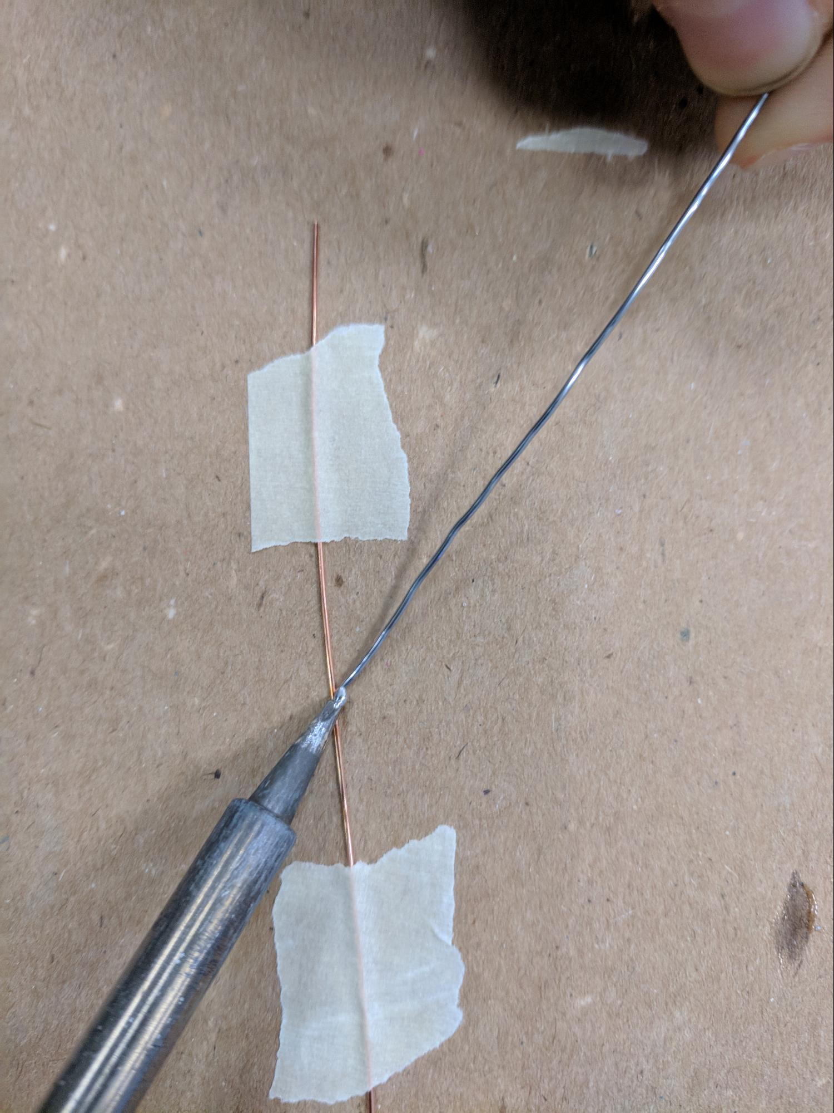
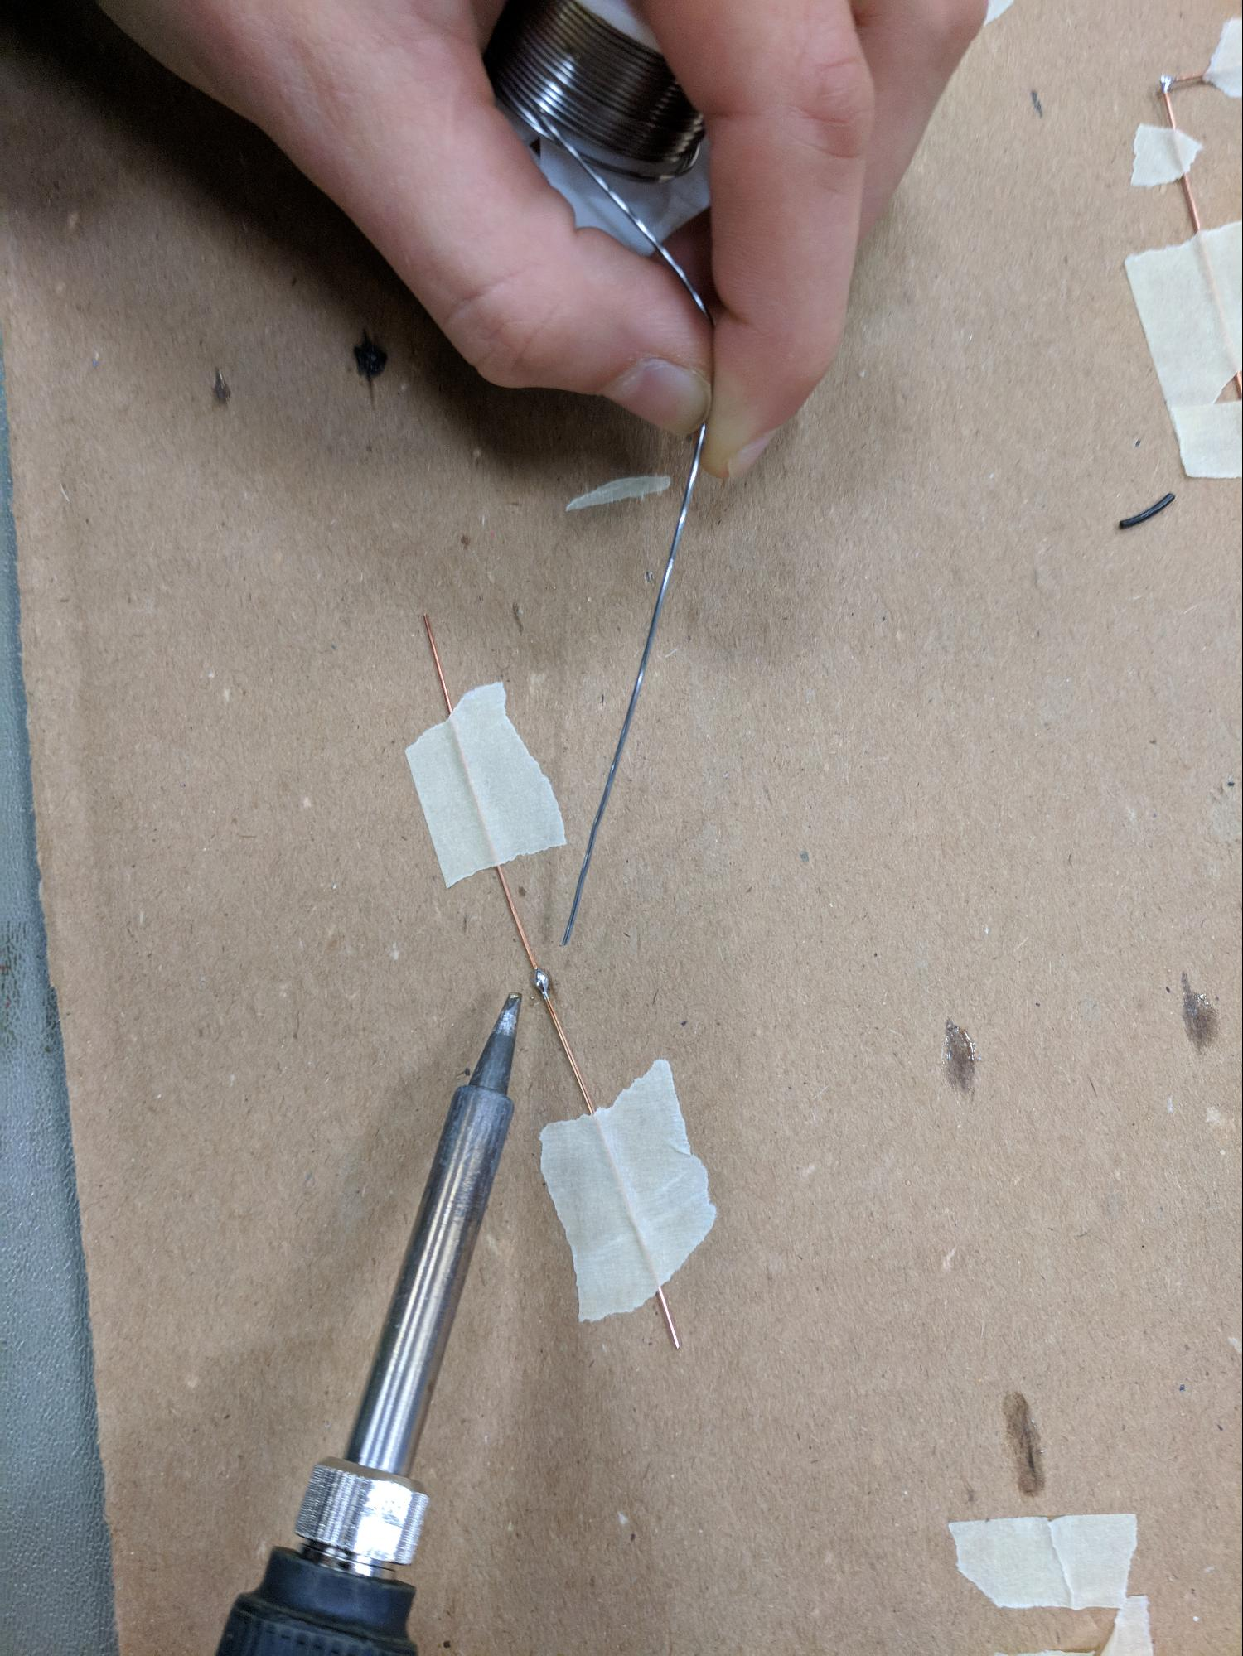
Step 4: Solder the pieces of copper together
1.Heat wire
2.Add solder
3.Finish

Slide 15
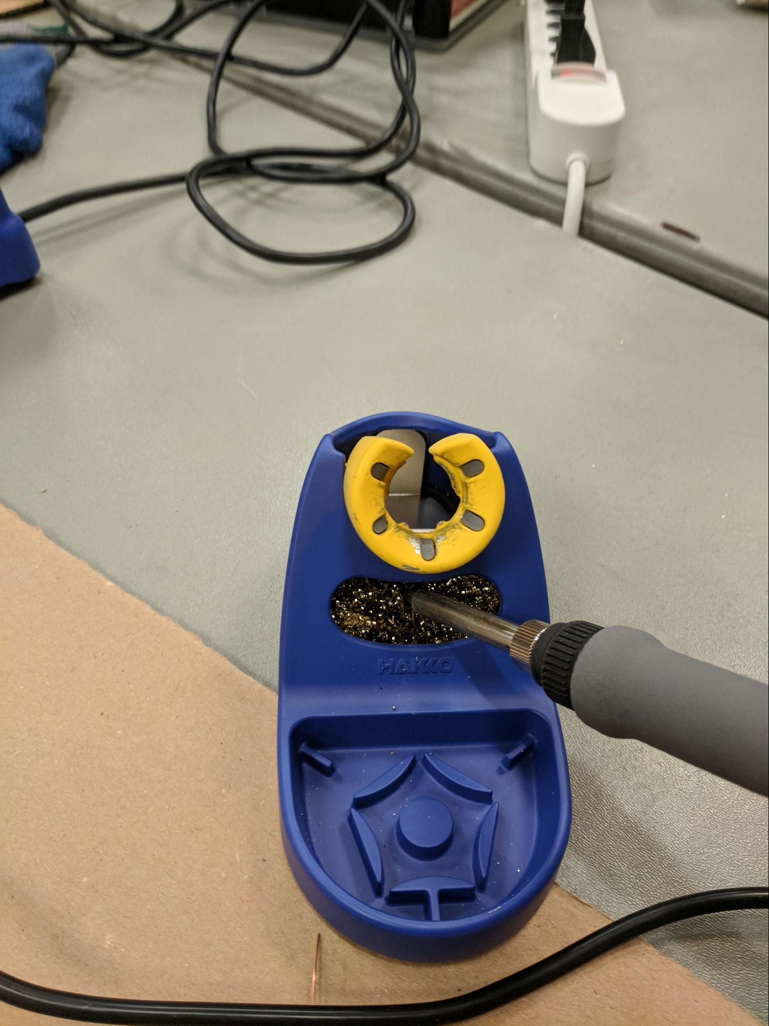
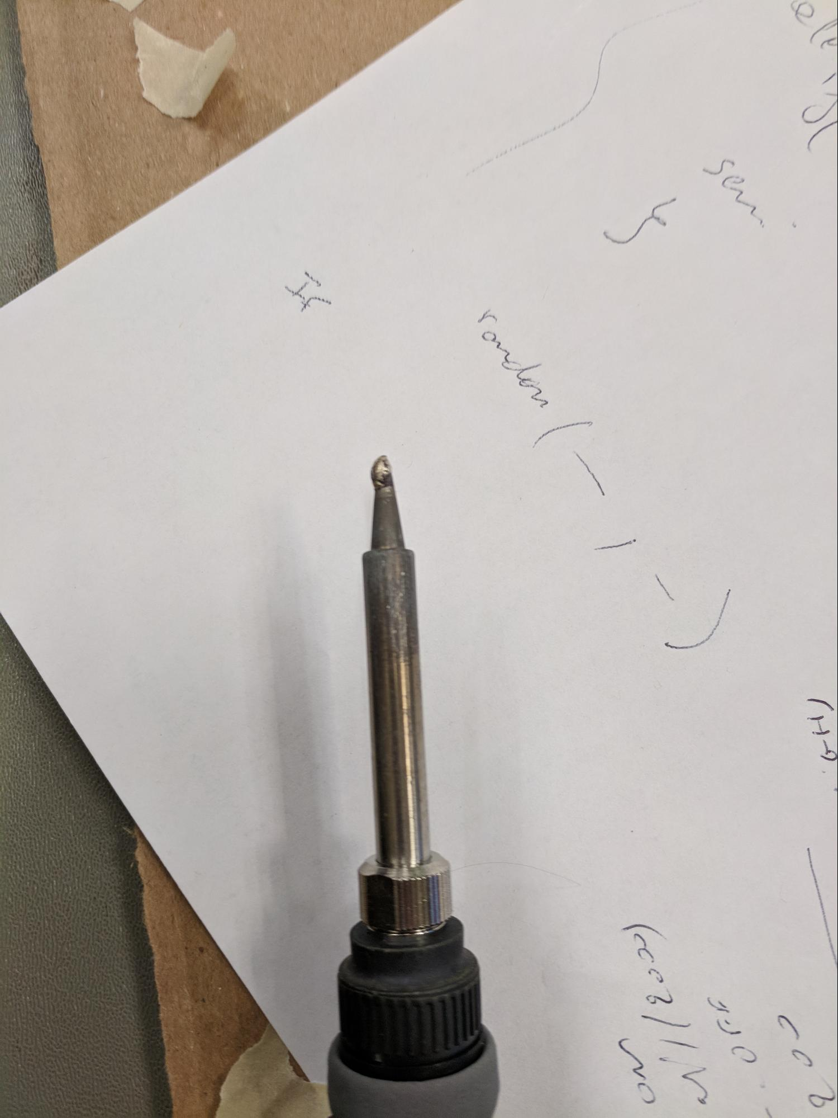
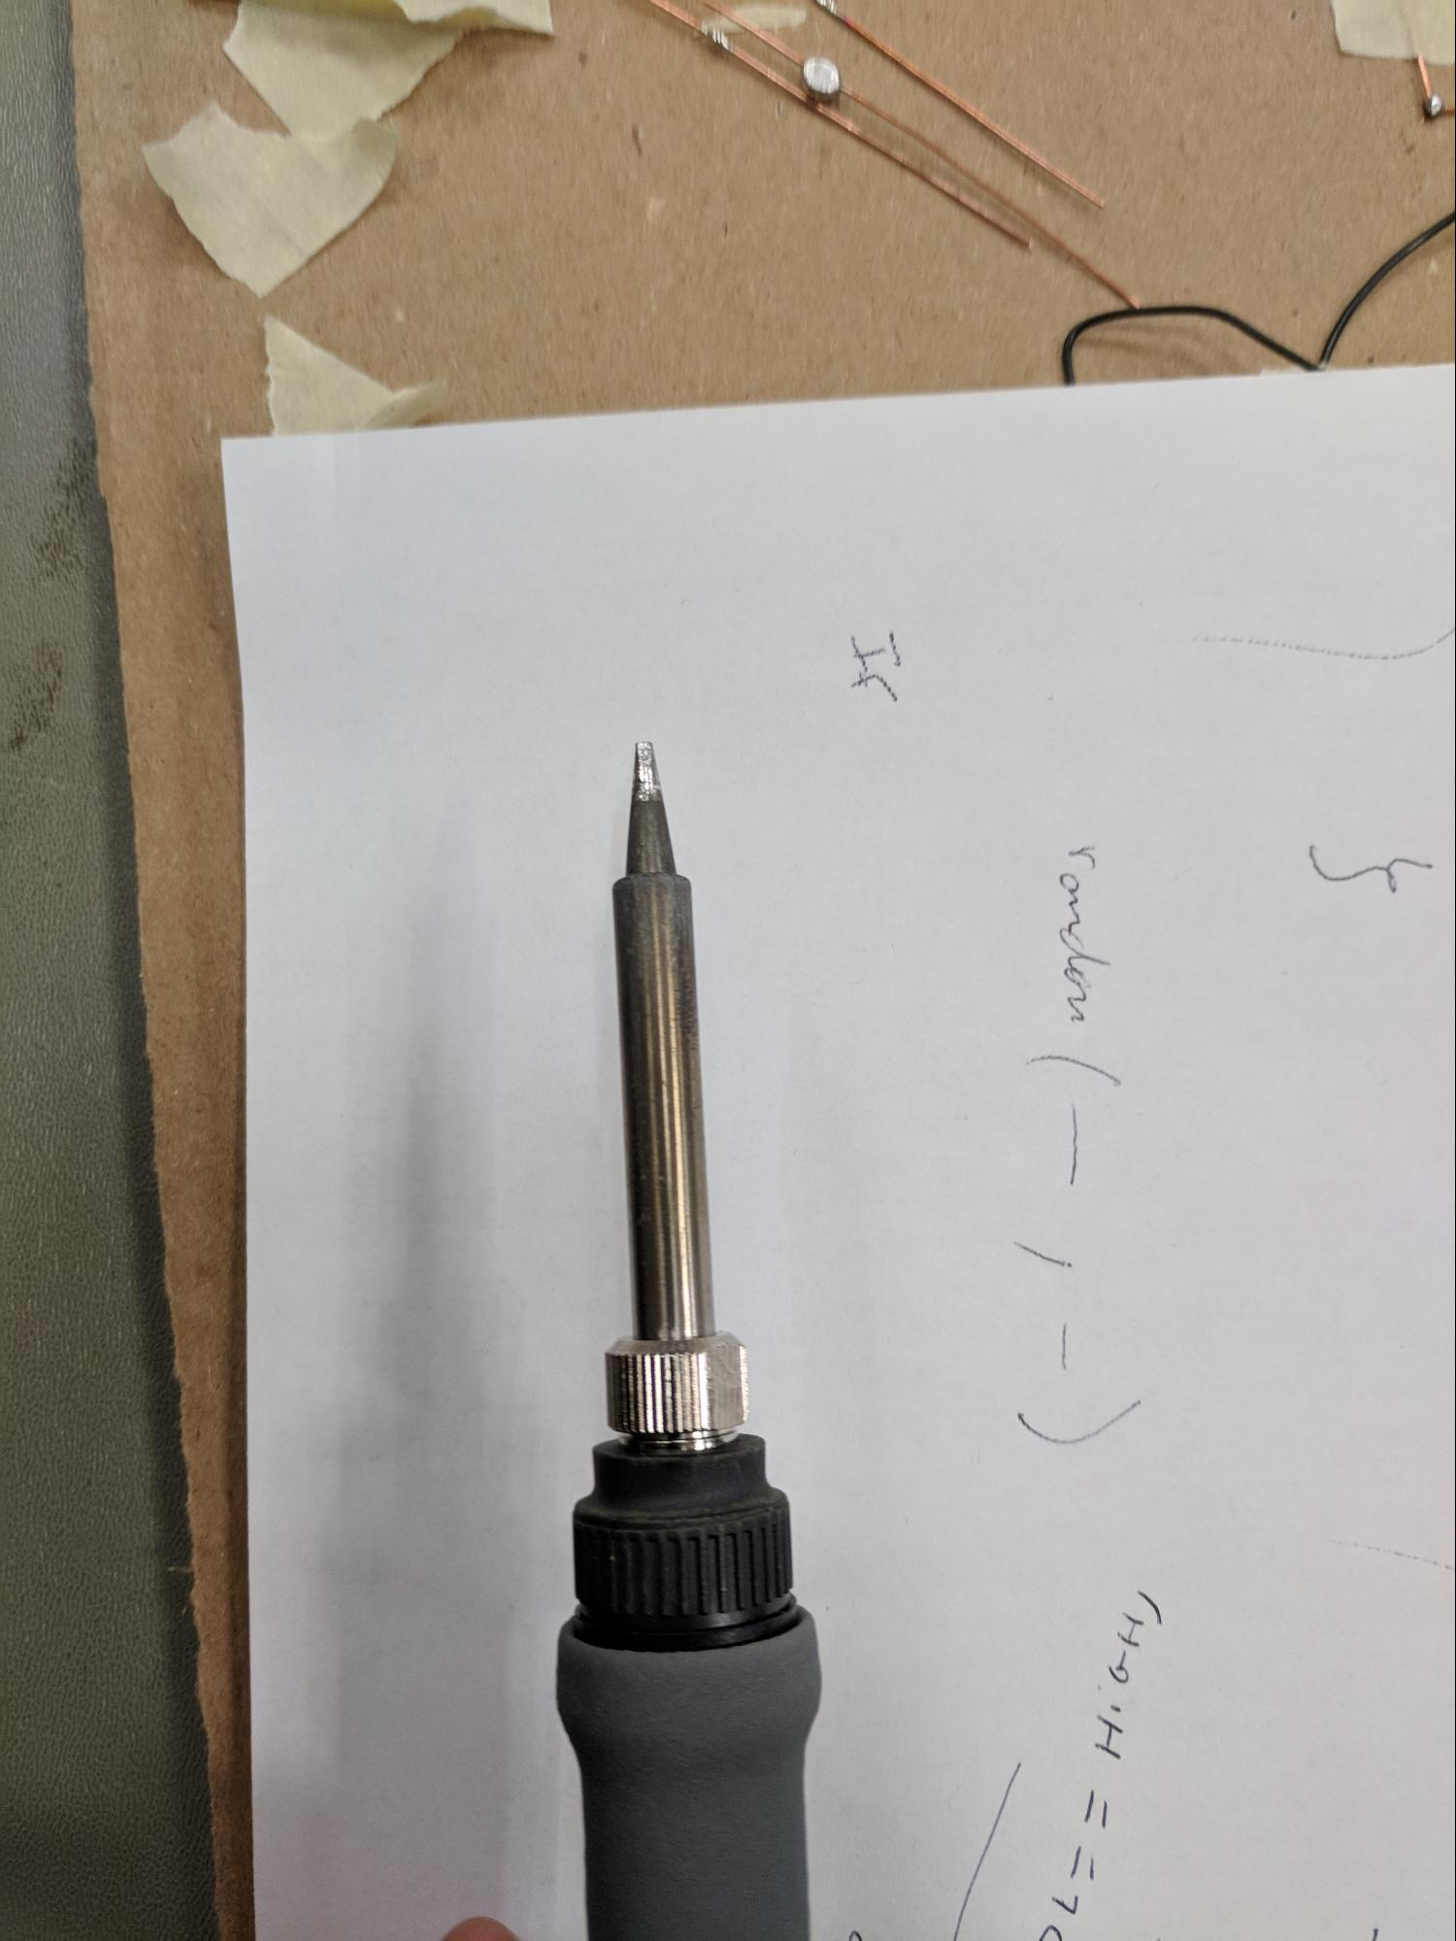
Step 5: Clean your iron and put it back in it’s holder
Dirty
Cleaning…
Clean

Slide 16
You just soldered 2 wires together! Untape them and try to pull them apart, if you can’t you did a good job!

Slide 17

Making a Cube

Slide 18
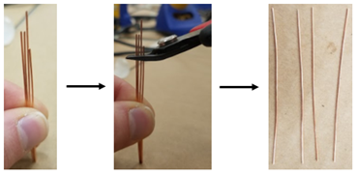
Step 1: Cut 4 equal pieces of copper wire, straighten them, and trim to the same length.

Slide 19
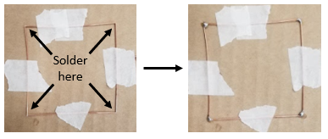
Step 2: Tape the 4 pieces of copper wire down in the shape of a square and solder the corners.

Slide 20
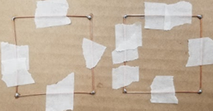
Step 3: Repeat steps 1 and 2 to create another square. Leave your squares taped down!

Slide 21
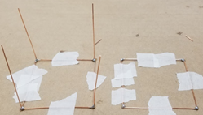
Step 4: Cut, straighten, and trim 4 more pieces of copper wire.

Slide 22
Step 5: Solder the 4 pieces of copper to the corners of one of your squares following the picture below!

Slide 23
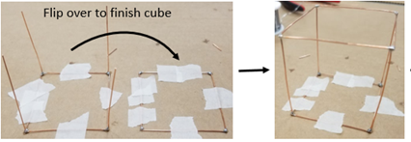
Step 6: Untape the square with legs and flip it over to finish the cube, following the pictures below.

Slide 24
Congratulations, you made a cube!

Slide 25
Try creating other objects!
Here are some ideas:
Write your name
Necklace
Pyramid
Car
Flower
Heart

Slide 26
THANKS !
QUESTIONS ????

